Slide 1
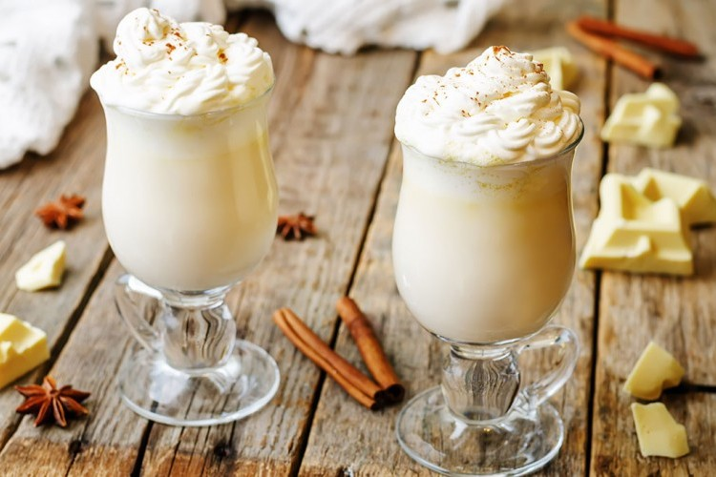
Enough for four people
The cooking time is 10 minutes
Hot white chocolate
Ingredients
- Milk: 4 cups (liquid)
- white chocolate: cup (excellent type, cut to small pieces)
vanilla extract: small spoon
- Salt: sprinkler (optional) - Marshmallow: as desired (and pale cream, white chocolate chips / for decorating)
preparation method
1. Milk is poured into a deep medium-sized pan, with white chocolate chunks and vanilla extract and salt, if used. And the mixture is constantly stirred, at medium heat, until the chocolate melts, keeping in mind that the drink is soft, and making sure that it doesn't boil.
2. The drink is immediately served and decorated as desired.

Slide 2
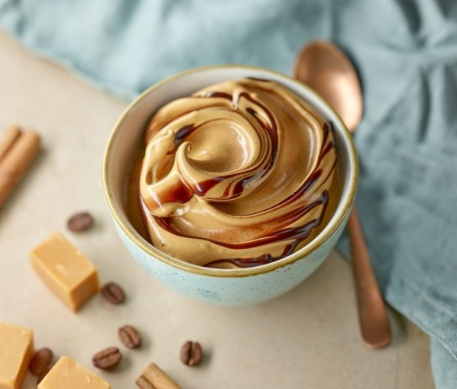
Enough for 2 people
The cooking time is 10 minutes
Melt the coffee with a cup of hot water, then place it in a pot and add hot milk and mix well.
Add caramel and sugar sauce, then stir the ingredients so they're completely homogeneous.
Pour the caramel latte into the cups of introduction, and decorate it with the cream and the caramel sauce, and then offer it.
Hot caramel latte
ingredients
- Milk: 2 cups (hot)
- Fast-melting coffee: Big spoon
- Hot water: cup
- Caramel sauce: a quarter cup
- Sugar, as desired
- Karima Khafaq: As desired (for decorative)
preparation method

Slide 3

Enough for 2 people
The cooking time is 10 minutes
How the cappuccino works
ingredients
- milk: cup (hot)
- Coffee: Cup (hot)
- sugar: big spoon
- cinnamon: a quarter of a little spoon
preparation method
Mix each of the following ingredients: milk, coffee, sugar, cinnamon, in the blender for at least 20 seconds until you have foam.
The cappuccino boy is in the cup with hot feet.

Slide 4
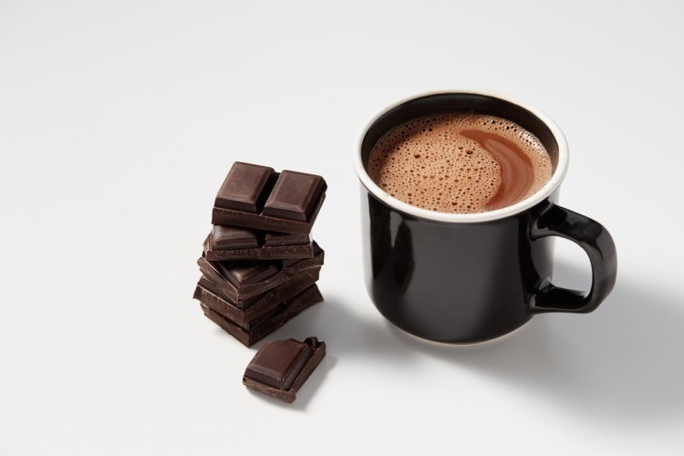
Enough for 3 people
The cooking time is 10 minutes
ingredients
- Milk: 1.5 cup
- cinnamon: small spoon and half (ground)
- Chocolate: half cup (grilled)
- Sugar: Big spoon and half
- A quarter cup of espresso
preparation method
Put cinnamon and milk in a pot on medium fire, and stir well until cinnamon smells go up.
Add chocolate, espresso, sugar and mixer to harmonize.
Put the hot chocolate in the pots with hot feet

Slide 5
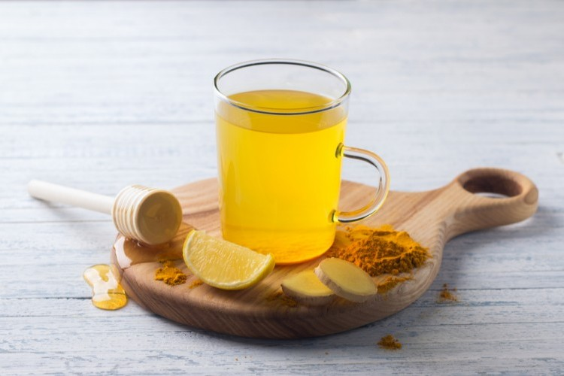
Enough for 3 people
The cooking time is 10 minutes
turmeric tea
ingredients
- Almond milk: 2 cups
- Honey: Big spoon
- turmeric: small spoon
- Cinnamon: Oud
- Ginger: half a teaspoon (grilled)
preparation method
Put all the ingredients together in a small pot on the fire and let it boil.
Clear the mixture and feet in cups to present.

